Slide 1
Goldman Sachs Consumer Finance Gadifele Mabale
Purpose of this project is to help the institution:
Enhance its loan approval processes
Deepen understanding of customer risk profiles
Predict defaults to protect financial health and improve profitability

Slide 2
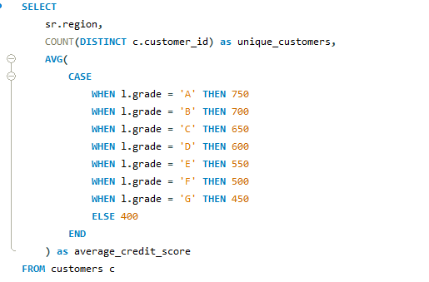
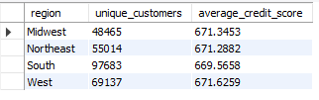
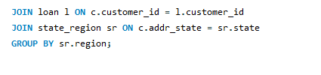
1. Retrieve the number of unique customers by region and their average credit score.

Slide 3
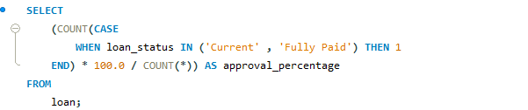

2. Calculate the percentage of approved loans out of total applications to evaluate approval efficiency.

Slide 4
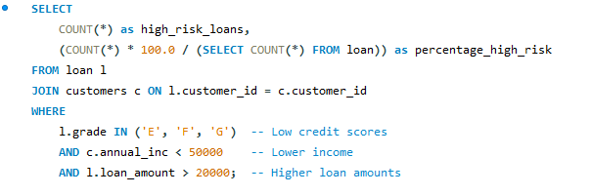

3. Identify loans with high default risk by flagging applications with low credit scores, lower income, and higher loan amounts.

Slide 5
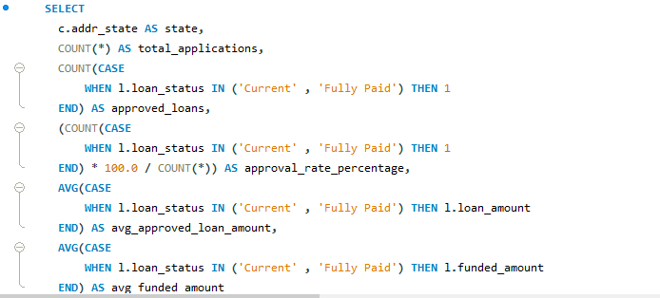
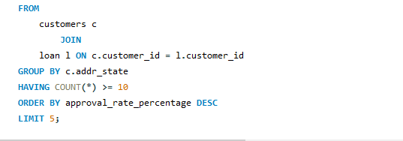
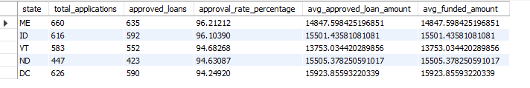
4. Find the top 5 states with the highest loan approval rates and compare them to their average approved loan amounts

Slide 6
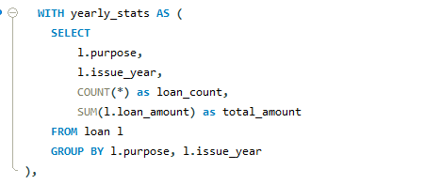
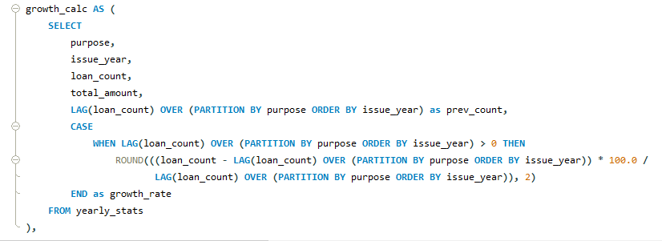
5. Analyze yearly trends in loan disbursement and identify which loan categories are growing fastest.

Slide 7
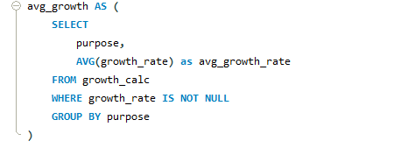
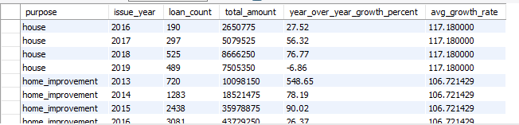
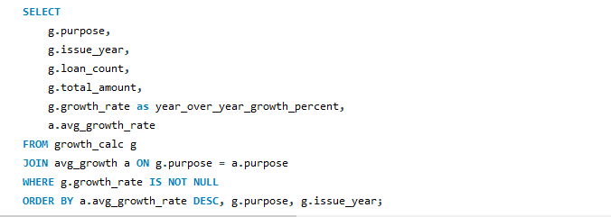
5. Analyze yearly trends in loan disbursement and identify which loan categories are growing fastest.

Slide 8
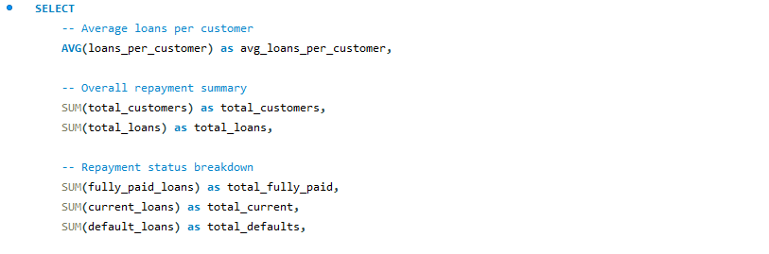

6. Find the average number of loans taken per customer and summarize their repayment history.

Slide 9
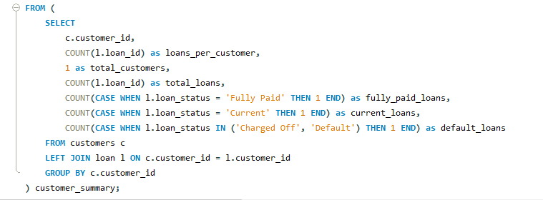
6. Find the average number of loans taken per customer and summarize their repayment history.

Slide 10
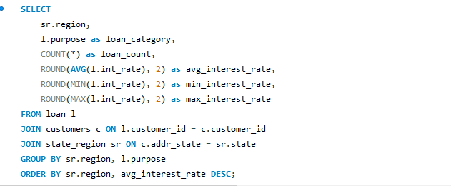
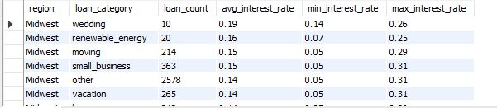
7. Calculate the average interest rate for loans by category and by region.

Slide 11
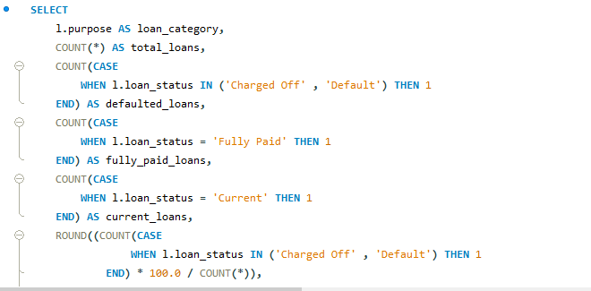
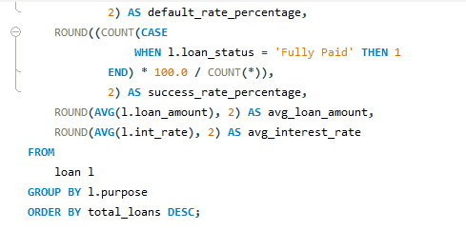
8. Identify the most common loan purposes (categories) and their associated default rates.

Slide 12
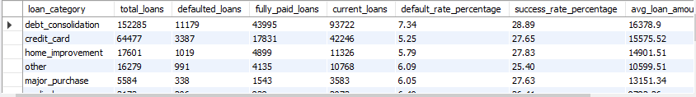
8. Identify the most common loan purposes (categories) and their associated default rates.

Slide 13
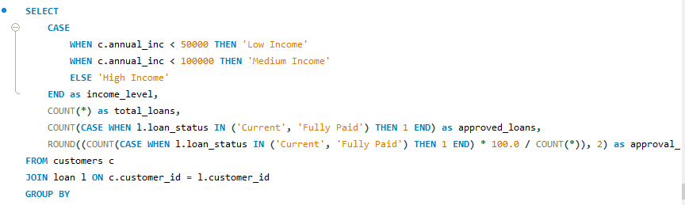
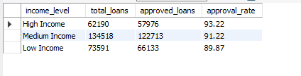
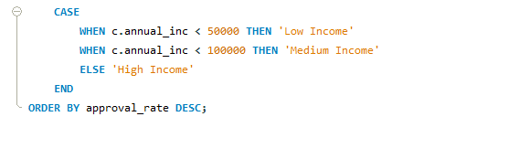
9. Analyze the correlation between income levels and loan approval rates.

Slide 14
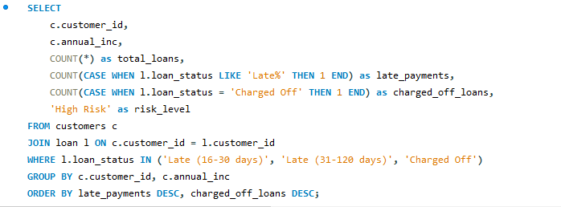
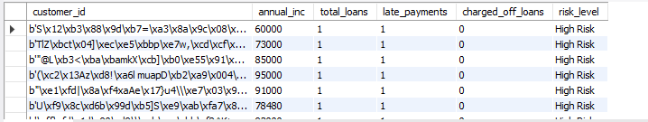
10. List customers who have missed multiple payments and are at higher risk of default.

